Slide 1
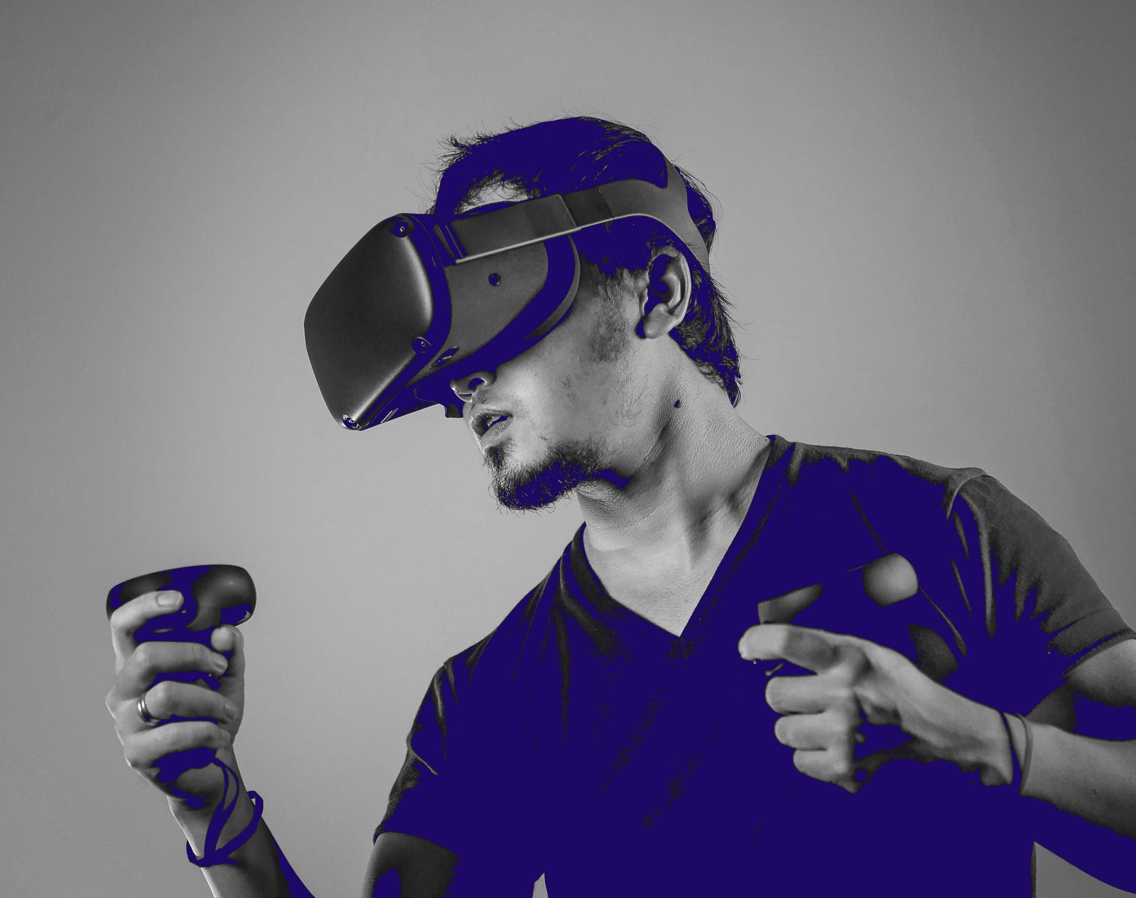
ICTOulu Road Show
Kokkola 26.9.2022

Slide 3
Oulu – myths and realities
Living in Oulu
International hub
Industries and business
Unique ICT Ecosystem
OULU – EXCITING FUTURE OF ADVANCED INNOVATON

Slide 4
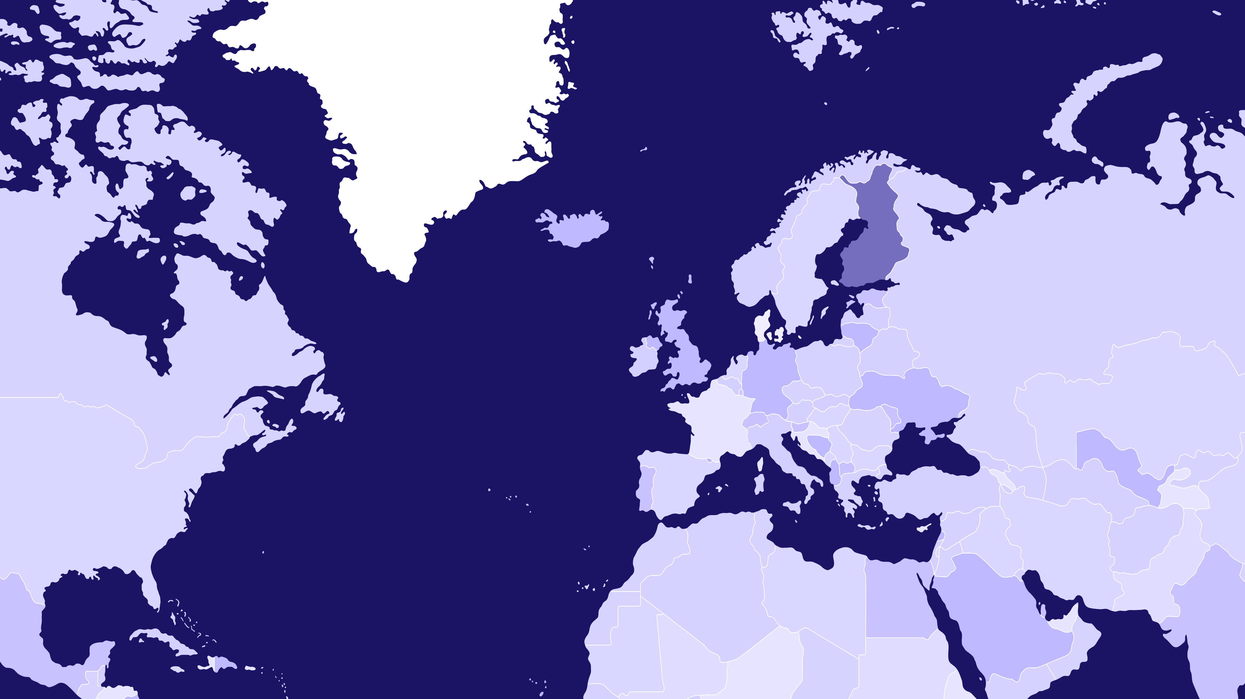
THE ARCTIC CIRCLE
Oulu-region is the Nordic tech hub
FINLAND
SWEDEN
NORWAY
OULU 65°01′N, 25°28′E
HELSINKI
+
1 000 tech companies
+
20 000 professionals
+
1 000 new talents annually
+
NUMEROUS TECHNOLOGICAL DOMAINS

Slide 5
250 000 inhabitants Metropolitan Area
Gateway to Arctic Europe and the most rapidly growing urban region in Arctic Europe
One of the youngest population in Europe
#1 in R&D investments in Finland
Among the top in the EU
1 in 3 people have a university degree
300–400 M€ city centre development projects
Only 50-minute flight away from Helsinki
Safe and a compact city
710 M€ to be invested in the infrastructure development in the near future
Nature is your nextdoor neighbour

Slide 6
FINLAND’S R&D EXPENDITURE PER CAPITA IN 2019
OULU | 2839
Vaasa | 2097
Helsinki | 1993
Tampere | 1700
Turku | 1350
Porvoo | 1300
Lappeenranta | 1100
Kuopio | 1000
Joensuu | 800
Rovaniemi | 550
Kajaani | 550

Slide 7
UNIVERSITIES
VTT
ICT COMPANY STACK
CITY OF OULU

Slide 8
Triple Helix of Support
UNIVERSITIES
VTT
Universities at different collaborative frontiers building talent pool
Trust and collaboration is written in Oulu-based stakeholders’ DNA
VTT enabling research and innovation
City of Oulu as active business and technology developer
ICT COMPANY STACK
ICT company stack operating at different intercommunicating domains
CITY OF OULU

Slide 9
Wide technological stack at your service
Green ICT
Health Tech
Machine Vision
Networks
Robotics
Software Development
Web 3.0
Consulting & Services
5G/6G/Connectivity
Datacenter
Processor Development/ SoC
Printed Electronics
IoT
Industry 4.0
Automotive
Cyber Security
Cloud
AI/ML
Blockchain
Electronics
Embedded Systems
Smart Manufacturing
Smart Machines

Slide 10
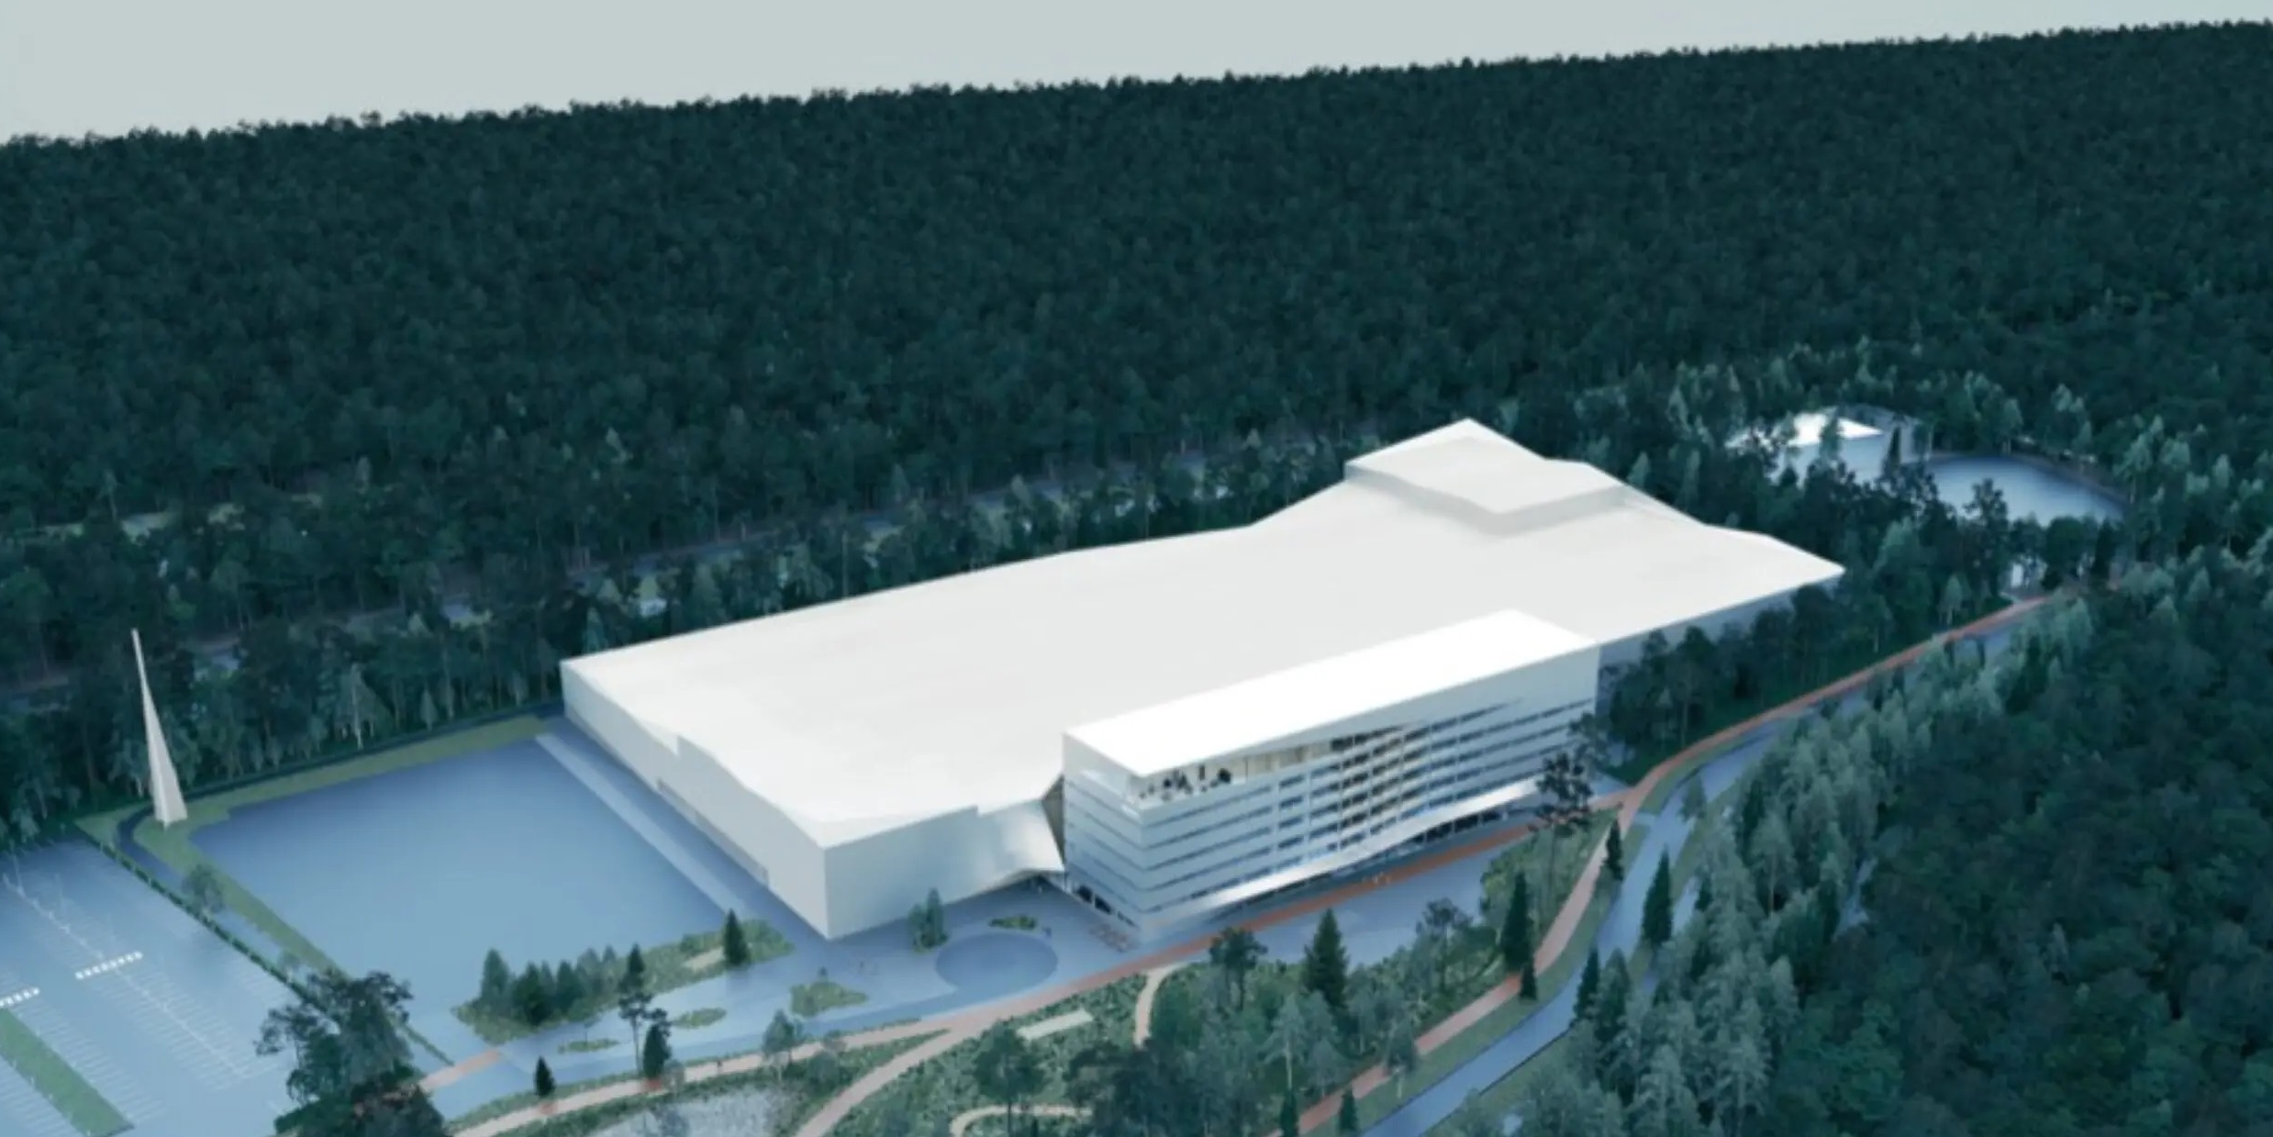
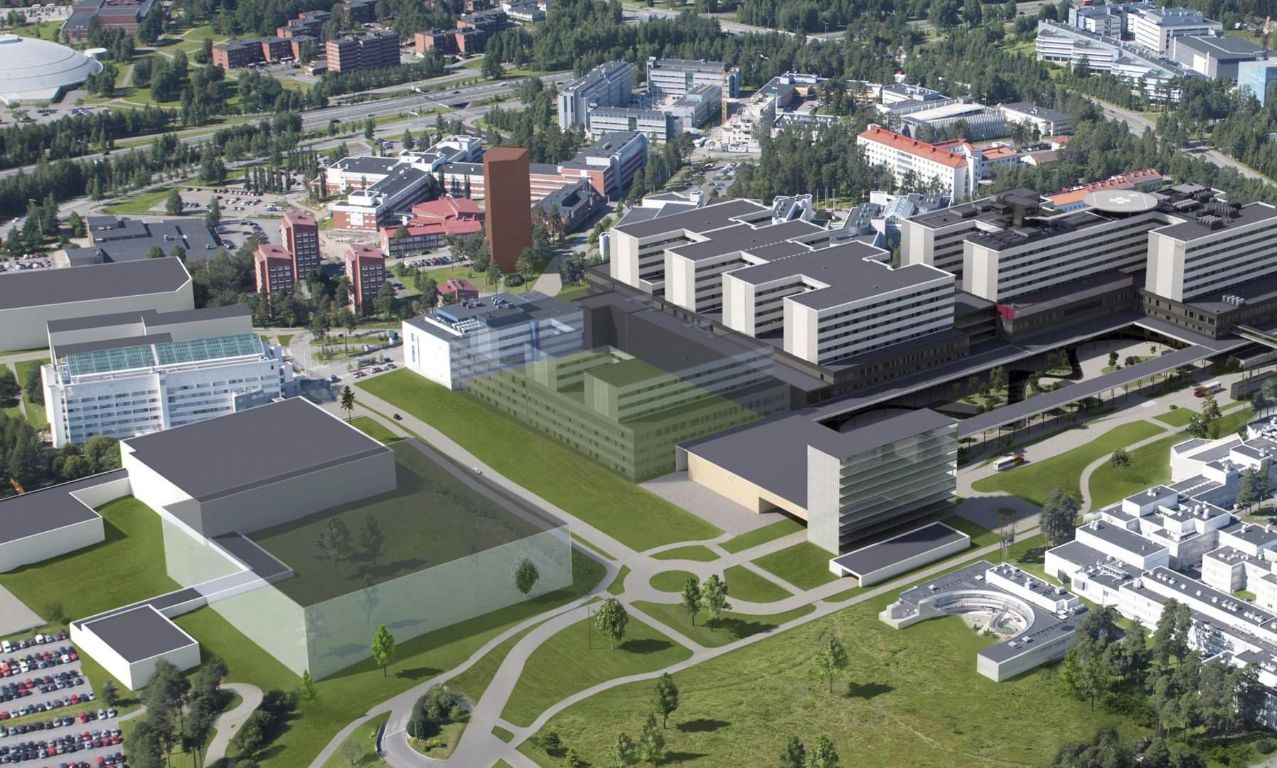
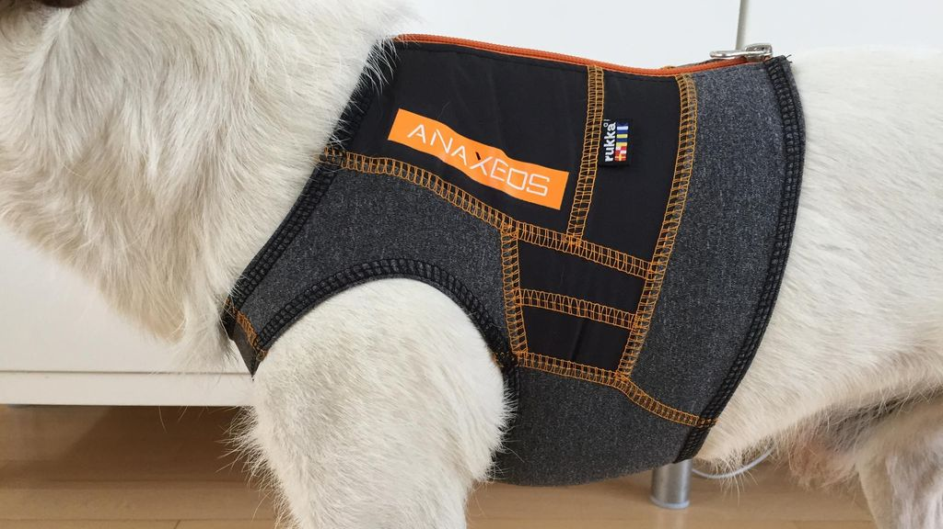
NOKIA CAMPUS
HOSPITAL OF THE FUTURE
Innovations and global level initiatives
RADIOPARK
IoT MAINSTREAM INTEGRATION

Slide 11
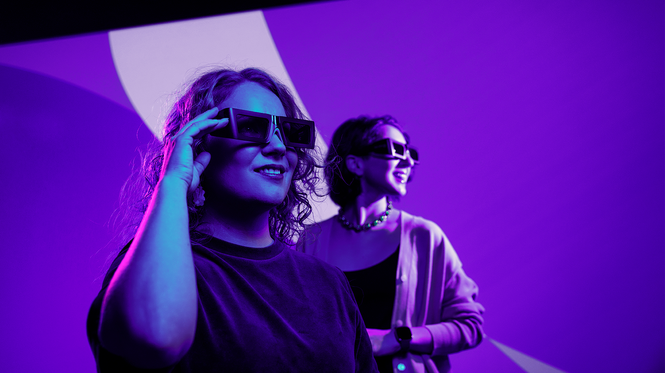
Master the Metaverse – in Oulu
Definitions
Something for everyone?
The big why
Drivers behind
Enabling technologies & applications
What happens in Oulu, stays in Metaverse

Slide 12
Examples of local companies hiring
Silo | Unikie | Boogie software | Nokia | Bittium | Aava Mobile | ABB | AiSpotter | Brightly | Botlabs
Buutti | Cerenion | CGI | Clouda-mite | CodeQ | Code-Mate | Comm-scope | Compu-line | Conver-gentia | CoreHW
Creatio | Creoir | CubiCasa | Detection Techno-logy | Diffo | DKA | Enhancell | EQ System | Etteplan | Finger-soft
Flex | Gofore | Graend | Haltian | Idesco | iLoq | iProtoXi | iSoft | Jot Auto-mation | Kaitotek
KeySight | Telenor Maritime | Liana | Loihde Trust | MeKiwi | Bosch Sensortec | Apple | Netox | Near Real | Nord-Cloud
Nordic Semicon-ductor | OffCode | Orbis Systems | Probot | Q4US | RajoBit | Rohm semicon-ductor | Siili Auto | Electrobit | Symbio

Slide 13
NOKIA

Slide 14
At Nokia, we create technology that helps the world act together

Slide 15
We are hiring SW, SoC, HW and Test Engineers!
We offer flexible working schemes and learning opportunities.
www.nokia.com/careers

Slide 16
SOLITA

Slide 17
We are Solita
Company Presentation
2022

Slide 18
We create value from data in a connected world.
Our aim is lasting impact by:
• Utilising data and IT
• Combining them with human insight
• Cooperating with our tech partners
Growth per annum
Turnover in EUR
2021
Founded in 1996
1500+ employees
6 countries
12 cities
Data
Design & Strategy
Cloud Connectivity Software development
20%
152M

Slide 19
Offerings & value creation:
Co-creating solutions with our clients
DESIGN
We identify and
analyze our clients’ digital
and data based opportunities.
DATA & DEVELOPMENT
We build solutions, data & analytical capabilities so that our clients can create value out of data.
CONNECTIVITY
We enable business by connecting data across organisations, systems and things.
CLOUD
We help our clients move to the cloud or optimize what they already have there.
Strategic Advisory
Enterprise Design
Service Design
Datanomics
Data Science, AI & ML
Data Engineering
Visual Analytics
Data Platform
Development
API Management
Integration
IoT
Cloud Managed Services
Cloud Consultancy
Cloud Migration

Slide 20
Open positions
Contact information: Julia Oksa, Talent Acquisition Manager (julia.oksa@solita.fi)
Software Development
Data
Cloud
Project Management
Web Full-Stack Developer (Java or .NET)
Web Front-end Developer (React.js)
Clojure Developer
Software Architect
Data Consultant (Tableau & PowerBI)
Machine Learning Architect
Integration Specialist (Mulesoft, Azure, Dell Boomi)
Cloud Advisor
Senior Cloud Consultant
Senior Azure Platform Specialist
Senior Project Manager
Many of our positions have remote work possibilities

Slide 21
NORDCLOUD

Slide 22
>40% net revenue growth YoY
Who we are
We are digital builders born in the cloud
1,000+ ninjas in 10 European hubs
1,000+ successful cloud projects
Visionary in Gartner’s Magic Quadrant
About Nordcloud
We’re recognized in The Financial Times’ league table of fastest-growing European companies
Triple-certified across Microsoft Azure, Google Cloud Platform and Amazon Web Services
Ninja team from over 40+ nationalities operating in 10 European countries
We supercharge our customers to embrace the world’s best technology
for Public Cloud IT Transformation Services

Slide 23
Who are we looking for?
Cloud Developer
Senior Developer
Software Developer
Cloud Architects and many more
Antti Honkanen
Team Lead
Elektroniikkatie 13, 90580 Oulu
antti.honkanen@nordcloud.com
+358 45 630 0147
Job opportunities
Apply now →
Home office or… the office. The choice is yours.
Apply now →
Check out all our job opportunities nordcloud.com/careers.
Apply now →
Apply now →

Slide 24
EXFO

Slide 25
EXFO – Who we are?
We're the communications industry's test, monitoring and analytics experts
Pioneering essential solutions and technologies for over 35 years
Oulu office located at Technopolis Linnanmaa with a headcount of around 50 people
EXFO’s Homeland Security Division provides solutions for Governmental Agencies worldwide
Notes:
Key message:
We have a unique platform to support your test, monitoring and analytics needs
Number 1 in fiber test and handheld test equipment
Simulation solutions to take you from design through to deployment and beyond
Protocol solutions for tomorrow’s speeds and feeds (400GE, eCPRI, Time Sensitive Networking (Ethernet TSN), OTN, and more
Virtualized active and passive monitoring – even for the most cost sensitive application (vCPE)
Active topology discover and advanced common cause analysis for virtualized networks
Advanced analytics and AI for operations support, including predictive and prescriptive troubleshooting

Slide 26
EXFO – Possibilities within the company
Our Oulu office has a lot of positions for a long career path including but not limited to
Software Engineer
Quality Assurance Engineer
Hardware Engineer
Mechanical Designer
Support Engineer
Production Engineer
Logistics Coordinator
Sourcing Coordinator
Product Manager
System Engineer
Quality Manager
IT Specialist
…
Please see the ICTOulu article about us for more information
https://oulu.com/ictoulu/news/get-to-know-exfo-and-their-open-positions/
Notes:
Esimerkkejä toimenkuvista Oulussa

Slide 27
EXFO – What we are looking for ?
We offer a hybrid working model for most of our positions, manufacturing for example is unfortunately not possible remotely
We are constantly looking for talent and currently we have the following positions open
Coordinator - Sourcing and Logistics
Manufacturing Engineer (Planner)
Manufacturing Engineer (Pre-Sales)
Project Manager
Software Developer (Front-End) – JavaScript & React
Please refer and apply from our Careers website https://www.exfo.com/en/careers/jobs/finland/
For more information
Jussi.Kamarainen@exfo.com
Pasi.Koskinen@exfo.com
Notes:
Esimerkkejä toimenkuvista Oulussa

Slide 28
BITTIUM

Slide 29
Bittium Company
Presentation
15.9.2022

Slide 30
Connectivity to be trusted
About Bittium
Bittium is a high-tech
company specializing
Key Figures
in Secure Connectivity,
R&D Services, Tactical
Communications
Founded in
Approximately
Net sales
Listed in Nasdaq
Helsinki
NPS score
1985
650
86.9M€
47*
employees
in 2021
BITTI
in 2022
and Medical
Technologies.
Headquarters in
Operating profit
3.2M€
Oulu
Finland
in 2021
Offices in
Finland,
Germany, US,
Mexicoand
Singapore
R&D investments
22.8%
of net sales
2
Bittium 2022 | Public

Slide 31
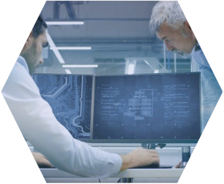
Products and Services
Connectivity
Enabled
Tactical
Communications
▪Military Radio and
Communications Solutions
▪Bittium Tough Mobile
Product Family
▪Special Devices
▪Secure Connectivity
Secure Mobile
Communications
R&D
Services
▪R&D Services for
Demanding Connected
Solutions
and Mobile Working
▪Medical Devices
▪Platforms for
Medical
Technologies
Biosignals’ Monitoring
Services and Analysis
3 Bittium 2022 | Public

Slide 32
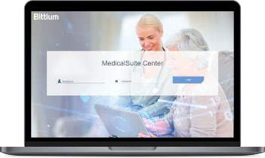
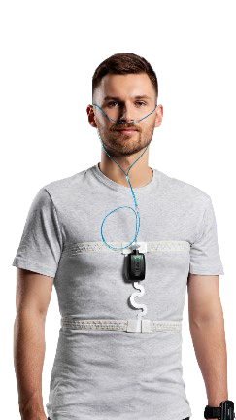
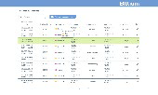
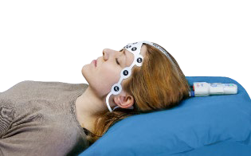
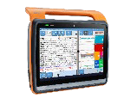
Medical Technologies
BiosignalsMeasuring and Monitoring
Bittium Medical Suite™Platform
Cardiology
Sleep Apnea
Reliable precision and flexibility
for cardiac monitoring and
analyzing
Home Sleep Apnea Testing
empowered with AI
Analysis and
report
Measurement data
for analysis
Measurement data
for analysis
Diagnostic report
with instructions
Neurology
Cutting edge neuro monitoring
with unique ease of use.
4 © Bittium 2022 | Public

Slide 33
Bittium Company Presentation 2022
Work Possibilities at Bittium
• We are constantly looking for designers for different projects, with
variety of skills and backgrounds. We are able to position different
experts to our projects so that both younger and more experienced
designers get the right kind of challenges and opportunities to expand
their skills.
• Our remote working policies are flexible, but we have noticed that Face-
to-face encounters cannot be completely replaced -we hope you could
work at the office for at least one day per week.
• Check our open positions at our website at https://jobs.bittium.com.
• We would like to hear from you!
5 © Bittium 2022 | Public

Slide 34
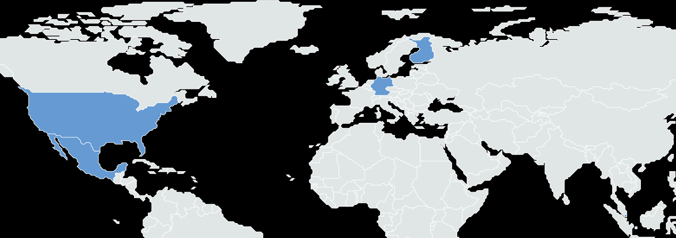
Bittium Corporation
Locations _{FINLAND}
1 ₂
3 _{Oulu, Headquarters}
1
Tactical Communications, IoT& Telecom
Services, Secure Communications, Medical
Technologies
4 ⁵
2
Kajaani
Tactical Communications, Telecom Services
USA
3
Kuopio
Seattle
Sales support
6
Germany
Munich
Sales support
Medical Technologies
7 ₇
4
Tampere
IoT& Telecom Services, Secure
Communications, Secure Connectivity Solutions
8 8
Dallas
Sales support
5
Espoo
MEXICO
Secure Connectivity Solutions
9
9 Mexico City
Sales and technical support
Singapore
Sales support
10
6
Bittium 2022 | Public

Slide 35
Contact us.
https://jobs.bittium.com/
tommi.harma@bittium.com

Slide 36
How to go forward?
Search www.ictoulu.fi for attractive technologies and potential employers
Contact the contact persons (you can find the contact information from portal’s company profiles)
Follow ICTOulu’s profile in LinkedIn for new weekly updates
Ask for both on site and distant working possibilities
Contact:
Jussi (jussi.leponiemi@businessoulu.com) or
Reeta (reeta.raisanen@businessoulu.com)
and share us with a summary of your backgrounds and we can help you to connect with attractive companies

Slide 37
Oulu welcomes you
Wide assets in many technologies – dozens of companies reaching to international markets
When working in Oulu’s ICT sector, you gain access to global level value chains and teams. You learn and deliver at the highest level.
Full-Stack location of connectivity
Ecosystem that generates real innovation and business value
Integration capabilities of different domains
Market-ready products and solutions for numerous cutting edge digital challenges

Slide 38
Notes:
OULU
- loppuyhteenveto

Slide 39
www.ictoulu.fi
Contact: jussi.leponiemi@businessoulu.com

