Slide 1
Thursday 17 November:
Oulu –
Masters of the Metaverse
www.ictoulu.fi

Slide 2
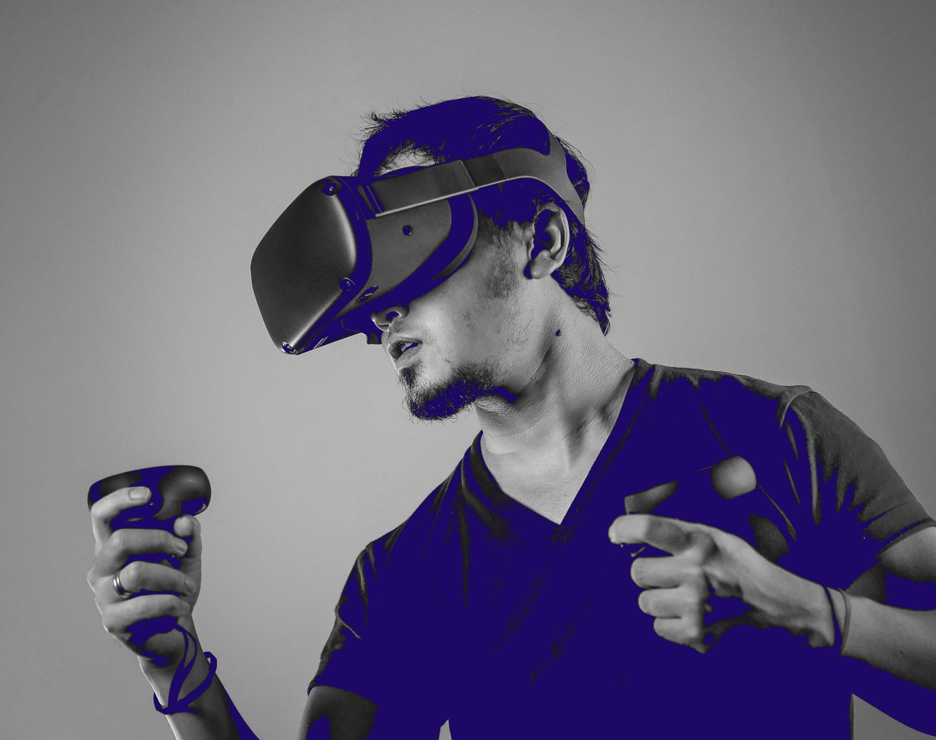
Agenda
08.45 Coffee / snack
09.00 Welcome, opening remarks & agenda
09.05 Introductions, panelists and media
09.30 ICTOulu presentation: ”Metaverse is made in Oulu” – Max Raymond
10.00 Panel discussion with ICT professionals from different companies and organisations in Oulu, Q & A
10.45 Conclusions and networking
11.00 Lunch at Antell Asema
12.00 Company visit: MeKiwi (VR/AR)
14.00 Option to attend Slush Official Side Event at BusinessAsema

Slide 3
Making the Metaverse in Oulu
17.11.2022
Max Raymond

Slide 4
What this presentation will cover
An overview of the metaverse and its current status.
What technology will be needed to power the metaverse.
Show why Oulu can be a go-to place for metaverse products and solutions.

Slide 5
The state of the metaverse in 2022

Slide 6
The metaverse – an overview
The metaverse is an evolution of how we interact with the internet, driven by a variety of technologies (3D and spatial computing, AR/VR, the blockchain, etc.).
We are gradually moving from a 2D online experience to a 3D one, via custom-built and immersive virtual worlds.
Many big technology giants have already invested in the metaverse, including Somnium Space, Meta, Microsoft, Alphabet, and NVIDIA.

Slide 7
According to the Ipos x World Economic Forum report
'How the World sees the metaverse and Extended Reality’
just over half (52%) of adults across 29 countries,
especially younger generations, say that they are familiar with the metaverse and widely expect that new experiences there will impact our lives over the next decade, in work, learning and entertainment.
UNIVERSITIES
VTT

Slide 8
The metaverse –
why companies are getting involved
A way of deepening the relationship between company and customer, enhancing business operations, and enabling new connections in B2B work.
Some of the methods used by companies include:
3D work in design and engineering phases, including 3D prototypes.
Creating new environments for training, bringing the whole process online.
New business meeting and networking opportunities.
Virtual events that can create brand awareness and sales opportunities.
We expect companies add metaverse functionality to existing products to make for a richer user experience – e.g. Microsoft incorporating Mesh into products such as Teams.

Slide 9
The metaverse in Finland
In Finland, there are already some noteworthy organisations and companies making waves.
The Finnish National Gallery has been piloting a new exhibition since October – a metaverse world that recreates the Finnish pavilion of the 1900 Paris World Fair.
Marimekko, one of Finland’s most recognisable consumer brands, has created a virtual flower field which will be unveiled over the next couple of days. They call it a place for users to “play, socialise, explore, and shop.”

Slide 10
The technology behind the metaverse

Slide 11
Wearable technology
Wearable devices such as VR headsets and smart
glasses are very familiar devices.
They’re not just games accessories - devices are used
in areas like fashion retail, the health sector,
and manufacturing and logistics industries.
The rise of wearable tech is unstoppable – the global wearable healthcare devices market is projected to reach 46.6 billion US dollars by 2025, an increase from 18.4 billion US dollars in 2020. (Source: Wearable Healthcare Devices Market report from Markets and Markets, December 2021)

Slide 12
Currently, in order to access a website or internet-based service, we are often relying on a single database stored on a cloud server.
Thanks to the blockchain, peer-to-peer networks of nodes would help power decentralised servers to keep the metaverse open for business. As these servers are decentralised, anyone can write to it and the 'machine' cannot be owned by a single entity.
In addition to increased system reliability and scale, the blockchain's unalterable and encrypted attributes means that there is greater protection against fraud and other unauthorised activities.
Decentralised servers

Slide 13
75% of enterprise-generated data will be created and processed outside traditional centralised data centres/clouds by 2025 (Source: What Edge Computing Means for Infrastructure and Operations Leaders, Gartner, 2018)
Like with servers, the connection would rely on a peer-to-peer network that is built on a community of users where no single entity is ever in complete control.
Benefits of this include greater system reliability, faster performance, increased scalability and greater privacy. In the future, this will also be a cheaper connection option for users and will save a lot of bandwidth.
Decentralised networks

Slide 14
The technological advances required
For the metaverse to be a seamless and satisfactory experience for everyone, the industry needs to:
Significantly develop connectivity infrastructure so that users can have an uninterrupted journey into the metaverse with no turbulence.
Develop hardware that can generate power for processes such as data consolidation, rendering and synchronisation, artificial intelligence, and even motion capture for specific applications.
Products and solutions must be accessible and easy-to-use from the user’s perspective in order to gain swift public buy-in.

Slide 15
ICT in Oulu – an overview

Slide 16
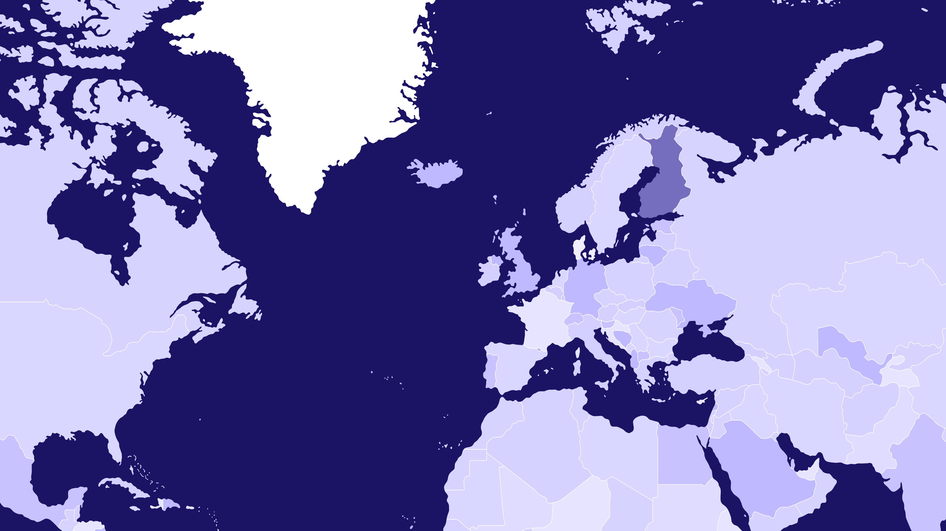
THE ARCTIC CIRCLE
Oulu-region is the Nordic tech hub
FINLAND
SWEDEN
NORWAY
OULU 65°01′N, 25°28′E
HELSINKI
+
1 000 tech companies
+
20 000 professionals
+
1 000 new talents annually
+
NUMEROUS TECHNOLOGICAL DOMAINS

Slide 17
An introduction to Oulu
250 000 inhabitants Metropolitan Area
Gateway to Arctic Europe and the most rapidly growing urban region in Arctic Europe
One of the youngest population in Europe
#1 in R&D investments in Finland
Among the top in the EU
1 in 3 people have a university degree
300–400 M€ city centre development projects
Only 50-minute flight away from Helsinki
Safe and a compact city
710 M€ to be invested in the infrastructure development in the near future
Nature is your nextdoor neighbour

Slide 18
THE ARCTIC CIRCLE
Oulu2026 –
European Capital of Culture
FINLAND
SWEDEN
NORWAY
OULU 65°01′N, 25°28′E
Oulu won its bid to become European Capital of Culture
in summer 2021.
Through cultural climate change, the project aims to inspire creativity, and make Oulu and the nearby region a vital place that attracts visitors, new residents, and takes care of their current citizens.
This also provides a major job creation opportunity for the local economy across many different sectors.
We believe that Oulu-based metaverse projects can support the Oulu2026 project goals and further boost the local economy.
+

Slide 19
Wide technological stack in your service
Green ICT
Health Tech
Machine Vision
Networks
Robotics
Software Development
Web 3.0
Consulting & Services
5G/6G/Connectivity
Datacenter
Processor Development/ SoC
Printed Electronics
IoT
Industry 4.0
Automotive
Cyber Security
Cloud
AI/ML
Blockchain
Electronics
Embedded Systems
Smart Manufacturing
Smart Machines

Slide 20
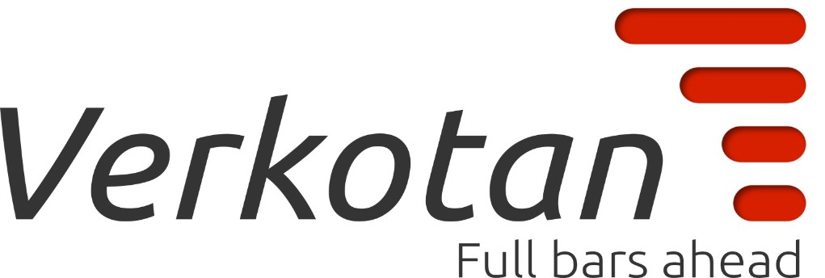
Leading edge connectivity research and development in Oulu
When people think of Oulu and technology, it’s our connectivity expertise that most people think of first.
Some of the most important mobile technologies such as GSM, wCDMA and LTE originated here.
Nokia has been an instrumental force in the technological advances to date and will continue to be going forward.
As well as our ground-breaking work in 5G, the University of Oulu is conducting pioneering research into 6G via its own specialist flagship unit.

Slide 21
Virtual reality and augmented reality in Oulu
Oulu as a city is very ambitious in this area.
We have a large array of businesses who are developing game-changing VR/AR solutions for a variety of sectors.
The benefits of our work include more immersive tourist experiences, increased efficiency in the workplace, and more.
This development work includes mobile, smart glasses, wearables, haptic, gestures, voice controls and neural.

Slide 22
Processing development in Oulu
Finland and Oulu have been active on this field not least because of the European Union Chips Act.
There is plenty of development work ongoing in the processor development/System on Chip field, as we expect these to be defining elements in the value chain surrounding the metaverse.
Edge computing is still a developing entity, and we are playing our part in the R&D process.
The Oulu University of Information Technology and Electrical Engineering is developing working applications to be utilised in several sectors.

Slide 23
Gamified solutions in Oulu
It’s likely that most of these virtual worlds will be built with engines that are perhaps best known for creating video games - specifically Unity and Unreal.
We have a tight-knit community of games development studios that can make gamified solutions for the private and public sectors.
It’s not just about their development skills - they also have the games know-how, which enables a great user experience.

Slide 24
Thank you for listening!
www.ictoulu.fi

