Slide 1
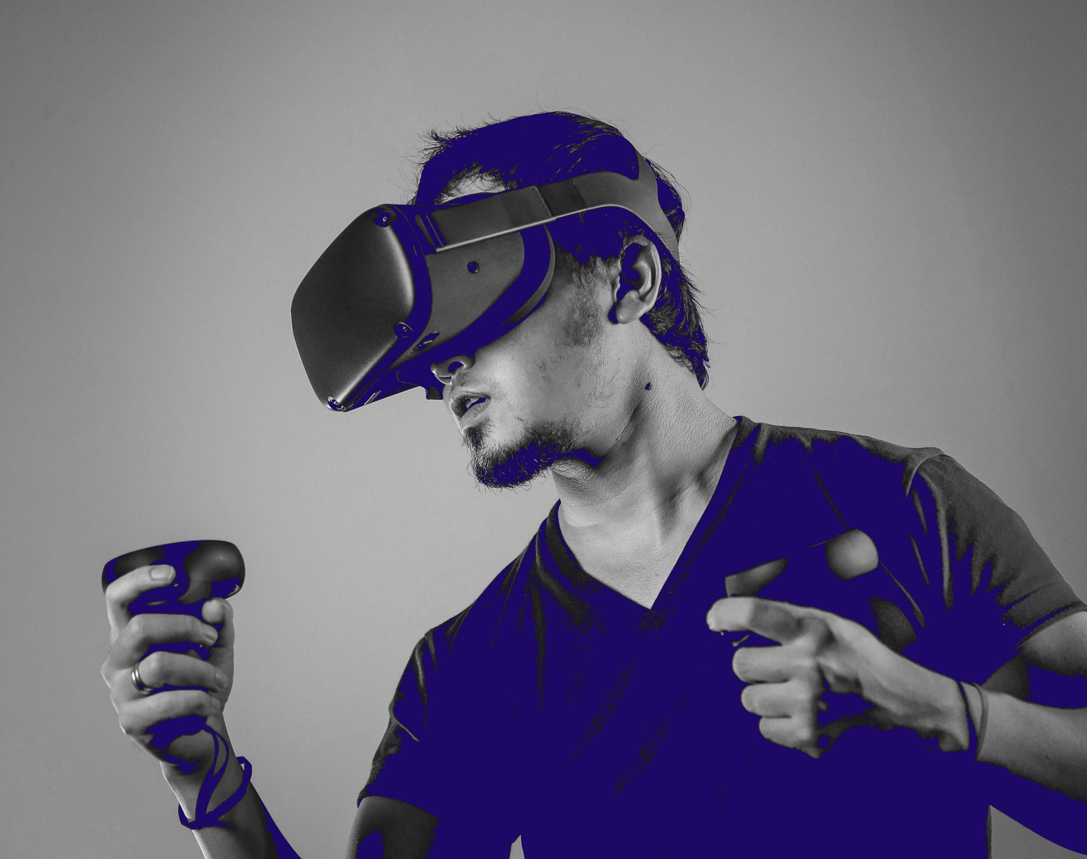
Presentation on Oulu’s ICT assets

Slide 2
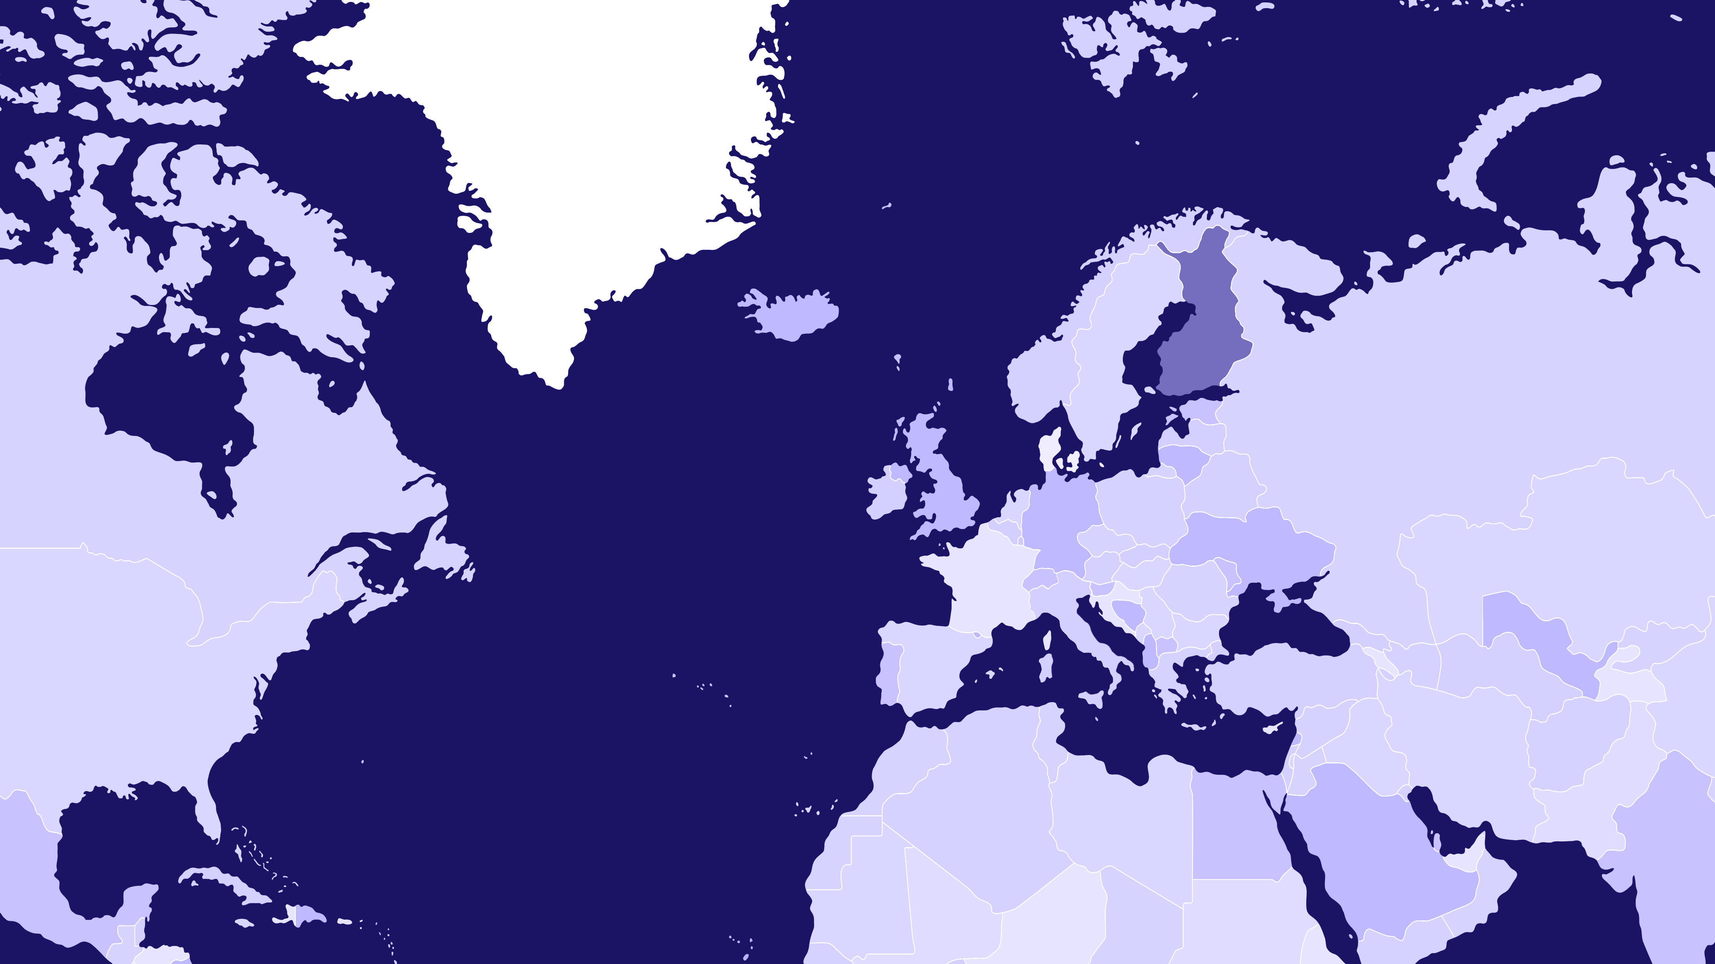
THE ARCTIC CIRCLE
The Oulu-region is the Nordic tech hub
FINLAND
SWEDEN
NORWAY
OULU 65°01′N, 25°28′E
HELSINKI
+
1 000 tech companies
+
25 000 professionals
+
1 000 new talents annually
+
NUMEROUS TECHNOLOGICAL DOMAINS

Slide 3
250 000 inhabitants Metropolitan Area
A gateway to Arctic Europe and the most rapidly growing urban region in Arctic Europe
One of the youngest population in Europe
#1 in R&D investments in Finland
Among the top in the EU
1 in 3 people have a university degree
300–400 M€ city centre development projects
Only a 50-minute flight away from Helsinki
A safe and compact city
710 M€ to be invested in infrastructure development in the near future
Nature is your nextdoor neighbour

Slide 4
FINLAND’S R&D EXPENDITURE PER CAPITA IN 2022
OULU | 3 437
Vaasa | 2 703
Helsinki | 2 345
Tampere | 2 169
Äänekoski | 1 972
Lappeenranta | 1 638
Turku | 1 428
Porvoo | 1 417
Jyväskylä | 1 355
Kuopio | 1 192
Joensuu | 999

Slide 5
UNIVERSITIES
VTT
ICT COMPANY STACK
CITY OF OULU

Slide 6
Oulu Innovation Alliance - OIA
UNIVERSITIES
VTT
A formal agreement between the state and the region on the deployment of R&D activities
Trust and collaboration is written in Oulu-based stakeholders’ DNA
The region’s key stakeholders engaged
An arena for development and significant project funding
ICT COMPANY STACK
Future city environment, health and well-being, and sustainability enabled by digitalization
CITY OF OULU

Slide 7
Wide technological stack in your service
Green ICT
Health Tech
Machine Vision
Networks
Robotics
Software Development
Metaverse / Web 3.0
Consulting & Services
5G/6G/Connectivity
Datacenter
Processor Development/ SoC
Printed Electronics
IoT
Industry 4.0
Automotive
Cyber Security
Cloud
AI/ML
Blockchain
Electronics
Embedded Systems
Smart Manufacturing
Smart Machines

Slide 8
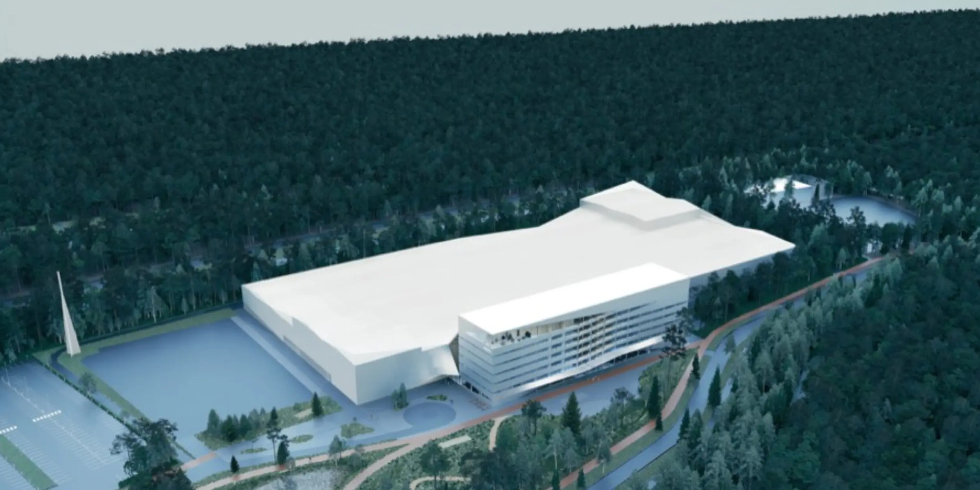
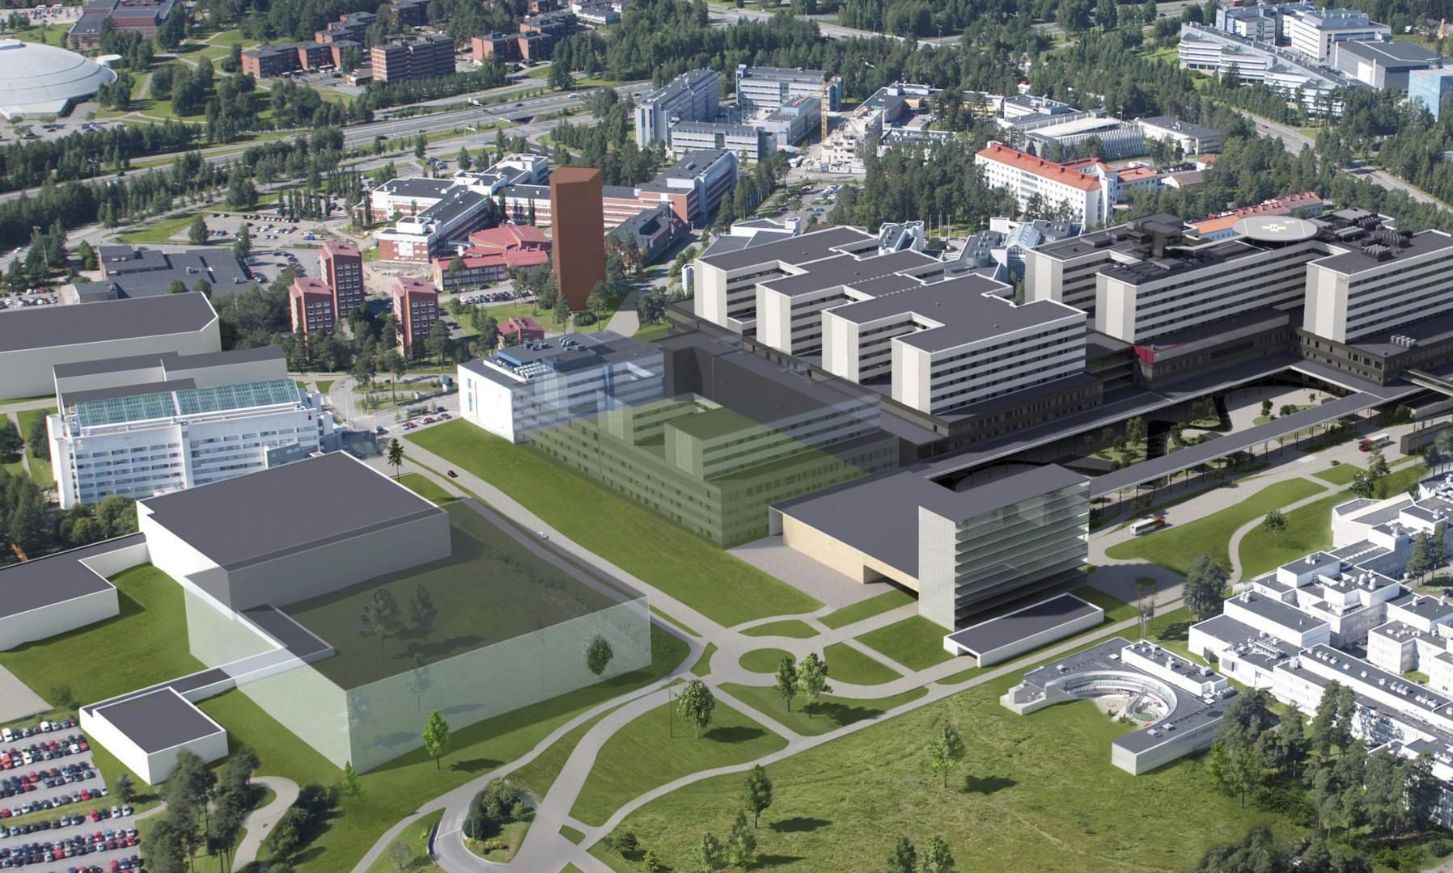
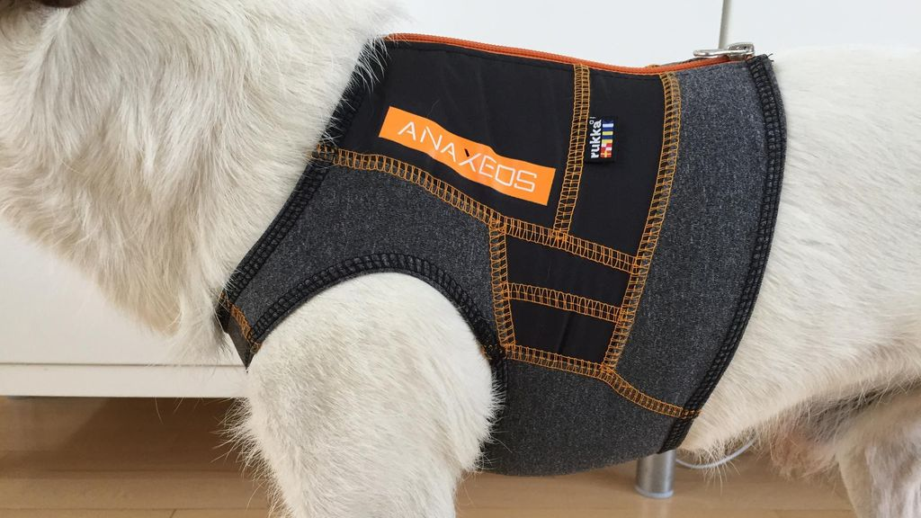
NOKIA CAMPUS
HOSPITAL OF THE FUTURE
Innovations and global level initiatives
RADIOPARK
FULL STACK IoT
LOCATION

Slide 9
NATO DIANA 6G TEST CENTRE IN OULU
DIANA - the Defence Innovation Accelerator for the North Atlantic
The University of Oulu, in cooperation with the VTT Research Center, hosts a 6G-technology-focused test centre for NATO DIANA.
The physical test centre is located at the University of Oulu, while VTT offers business accelerator.

Slide 10
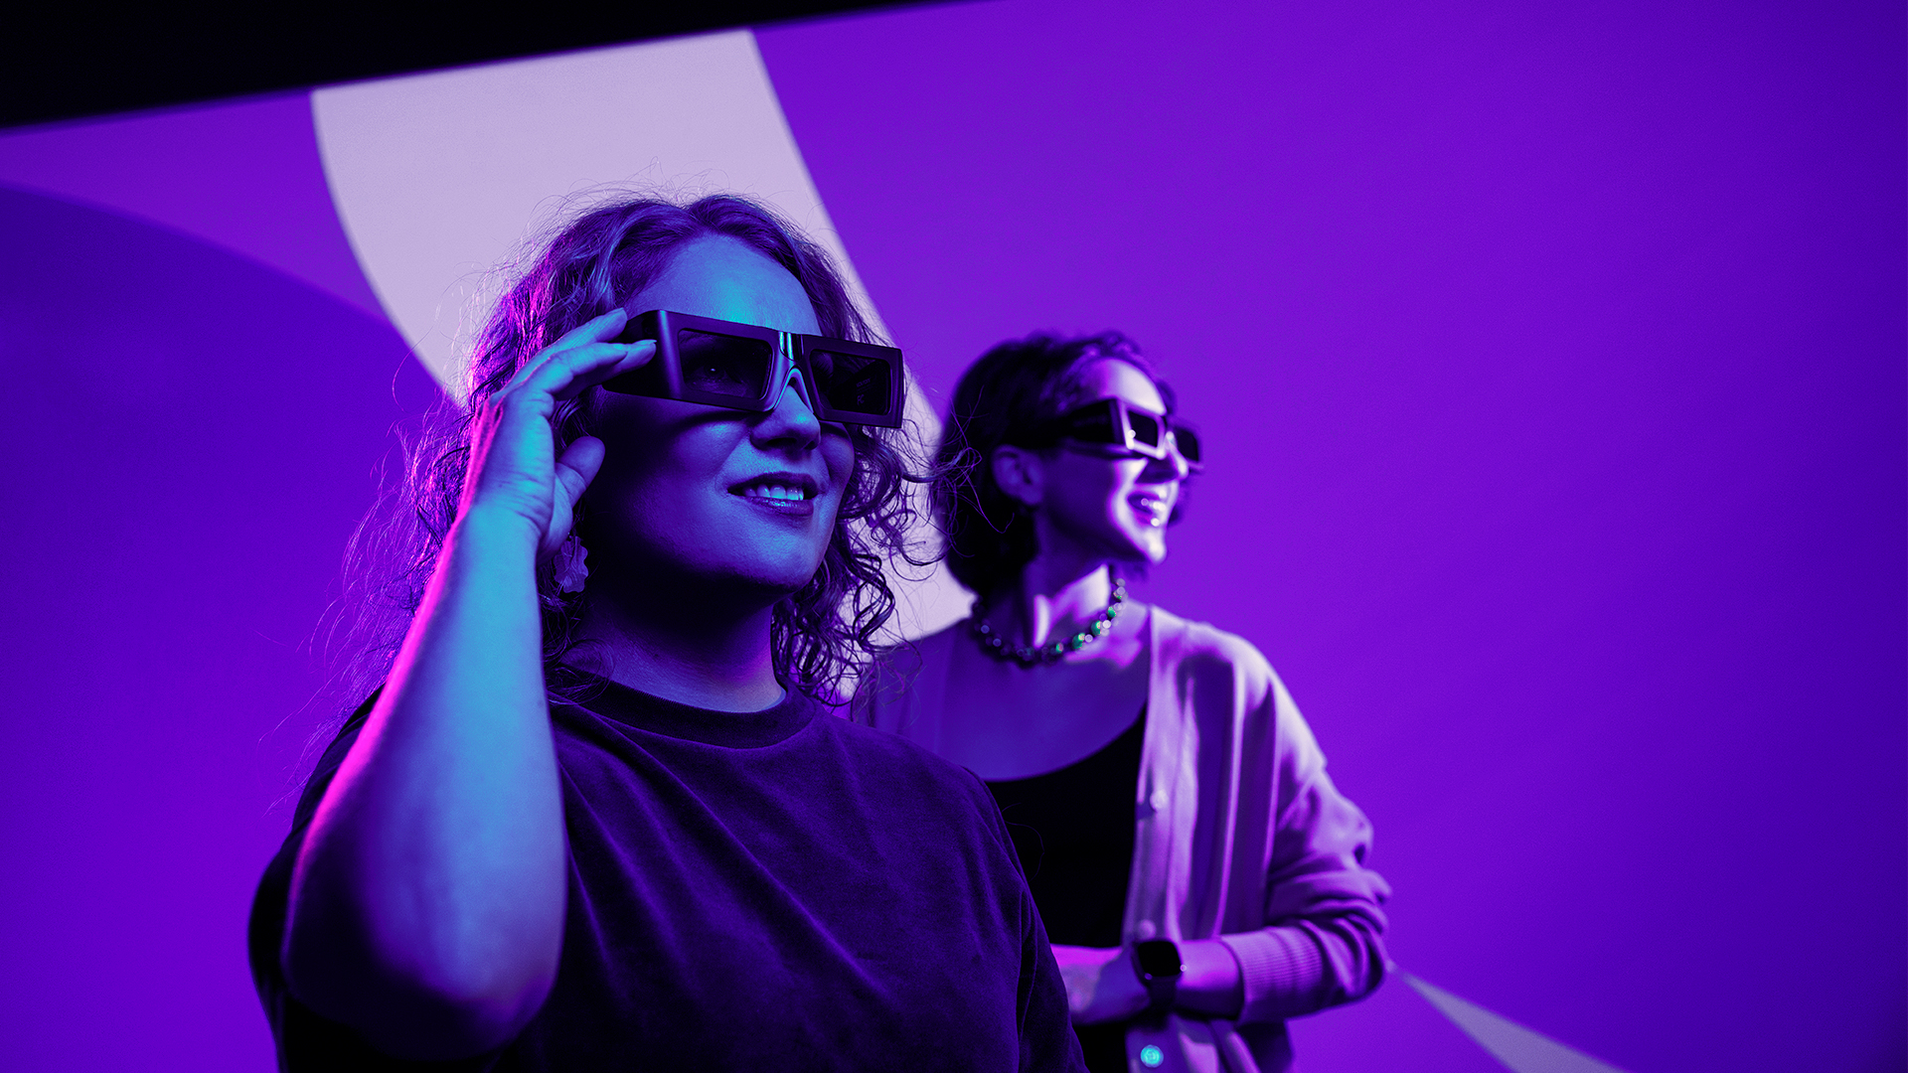
The Talent
+25 000
In the existing ICT talent pool
1 000
Local new graduates annually
GOOD AVAILABILITY of
SW Developer domains,
RF Application specialists
and IoT developers
Notes:
Positive experiences on Talent attraction initiatives
Good availablity of Challenges in specific mems-related themes, still positive development in this area as well

Slide 11
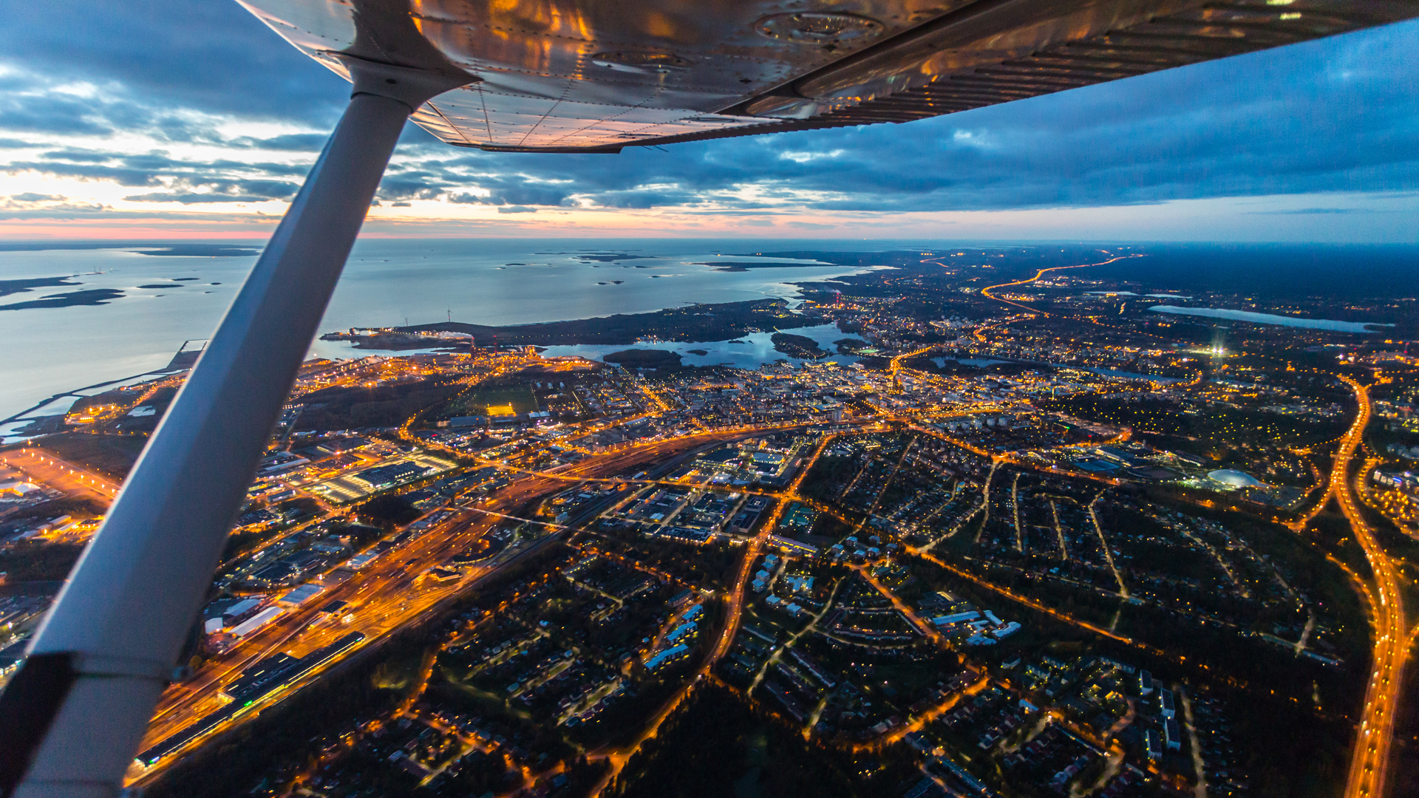
Oulu welcomes you
Wide assets in many technologies – dozens of companies reaching to international markets
Our key strenght is the developing availability of talents – a dynamic large local talent pool and flood of new graduates
A Full-Stack location of connectivity
An ecosystem that generates real innovation and business value
Integration capabilities of different domains
Market-ready products and solutions for numerous cutting-edge digital challenges

Slide 12
www.ictoulu.fi
Contact: jussi.leponiemi@businessoulu.com

