Slide 1
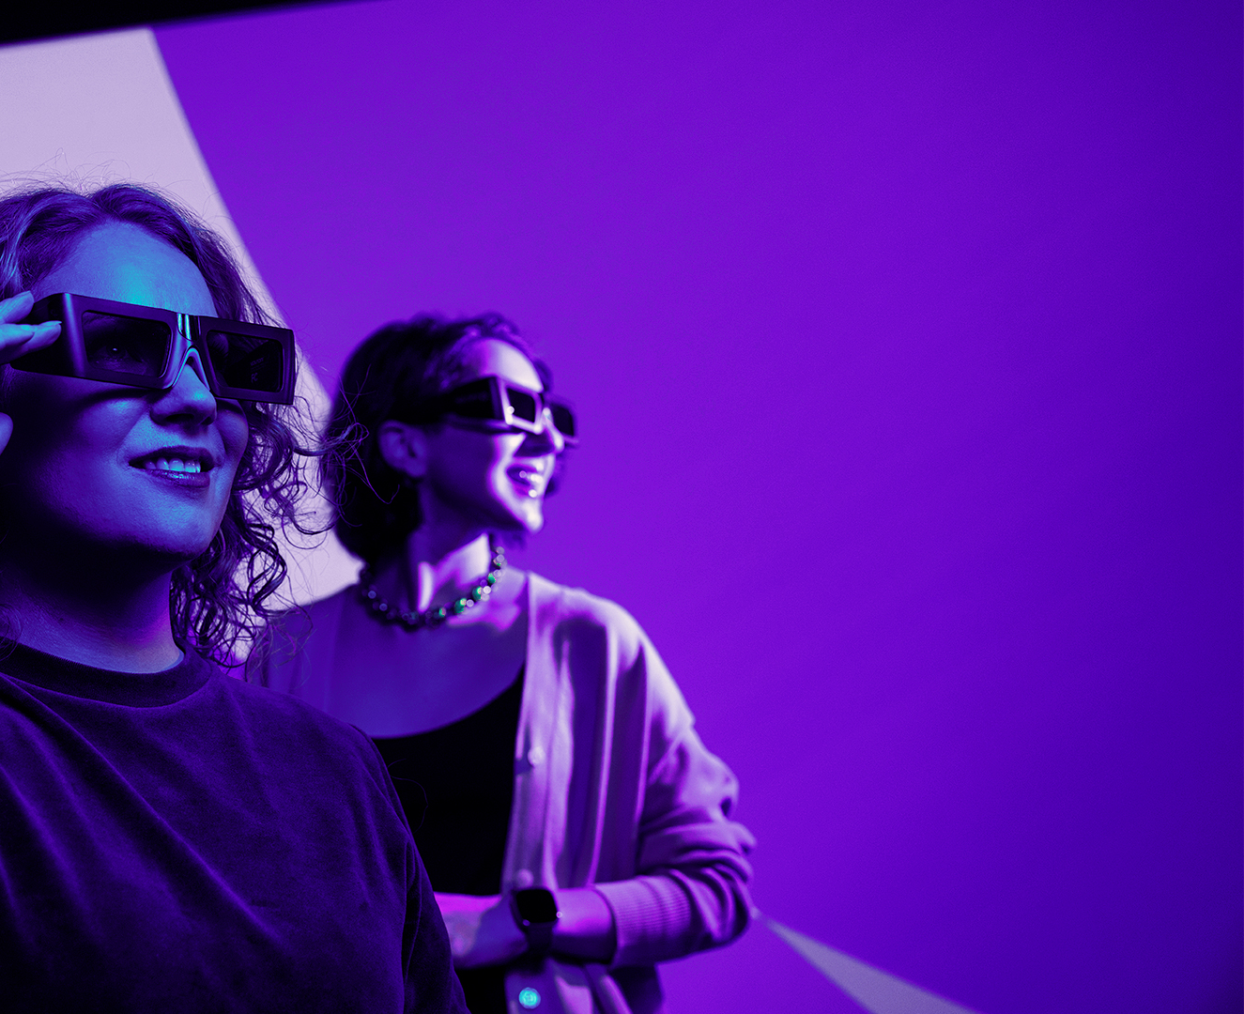
Oulu’s ICT sector
#1 in R&D investments in Finland and among the top in the EU
Pioneer in wireless core technology – huge legacy enabling technology development & applications
Ca. 30 tech domains with dedicated developer sme companies and IPR ownership, such as AI/ML, SoC, Edge AI, Green ICT, IMSE, Robotics, cyber sec. etc.
Global level initiatives and projects, such as RadioPark, Nokia Campus ecosystem development, Chips Fabless Design development initiative
Good and developing availability of the talent: SW developers, architects, cloud migration specialists, RFIC & digital SoC devs., Firmware devs., RF applications, IoT developers
+
+
1 000 new talents annually
1 000 tech companies
+
25 000 professionals
Read more at ictoulu.fi

